Slide 1
Decadal SST Variability in the East Asian Marginal Seas over Recent Decades: Warming, Hiatus, and Reacceleration

Slide 2
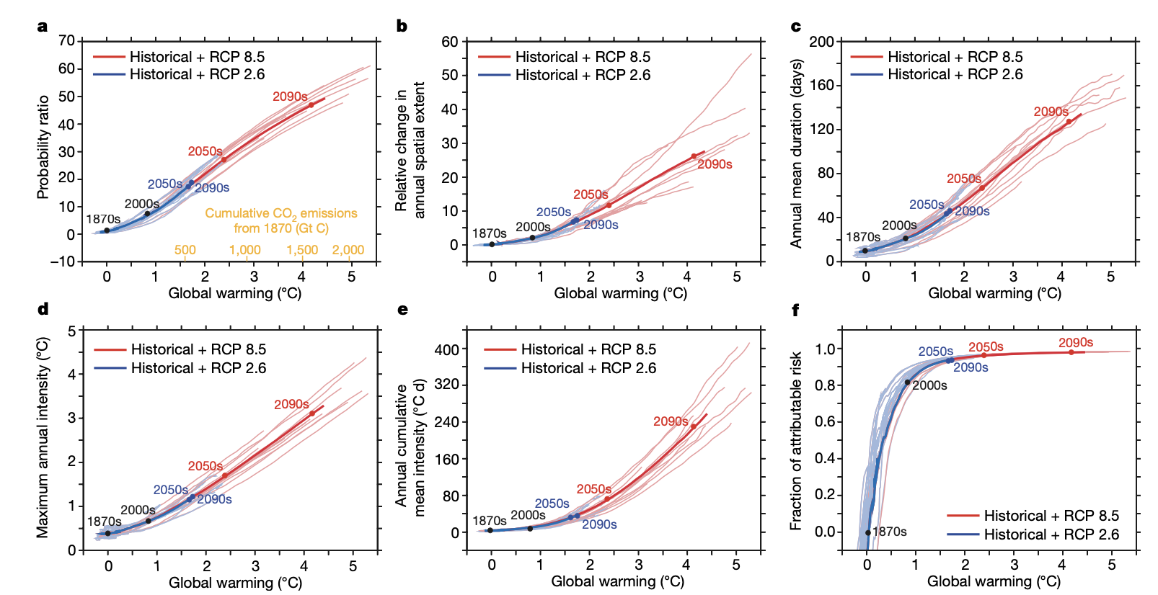
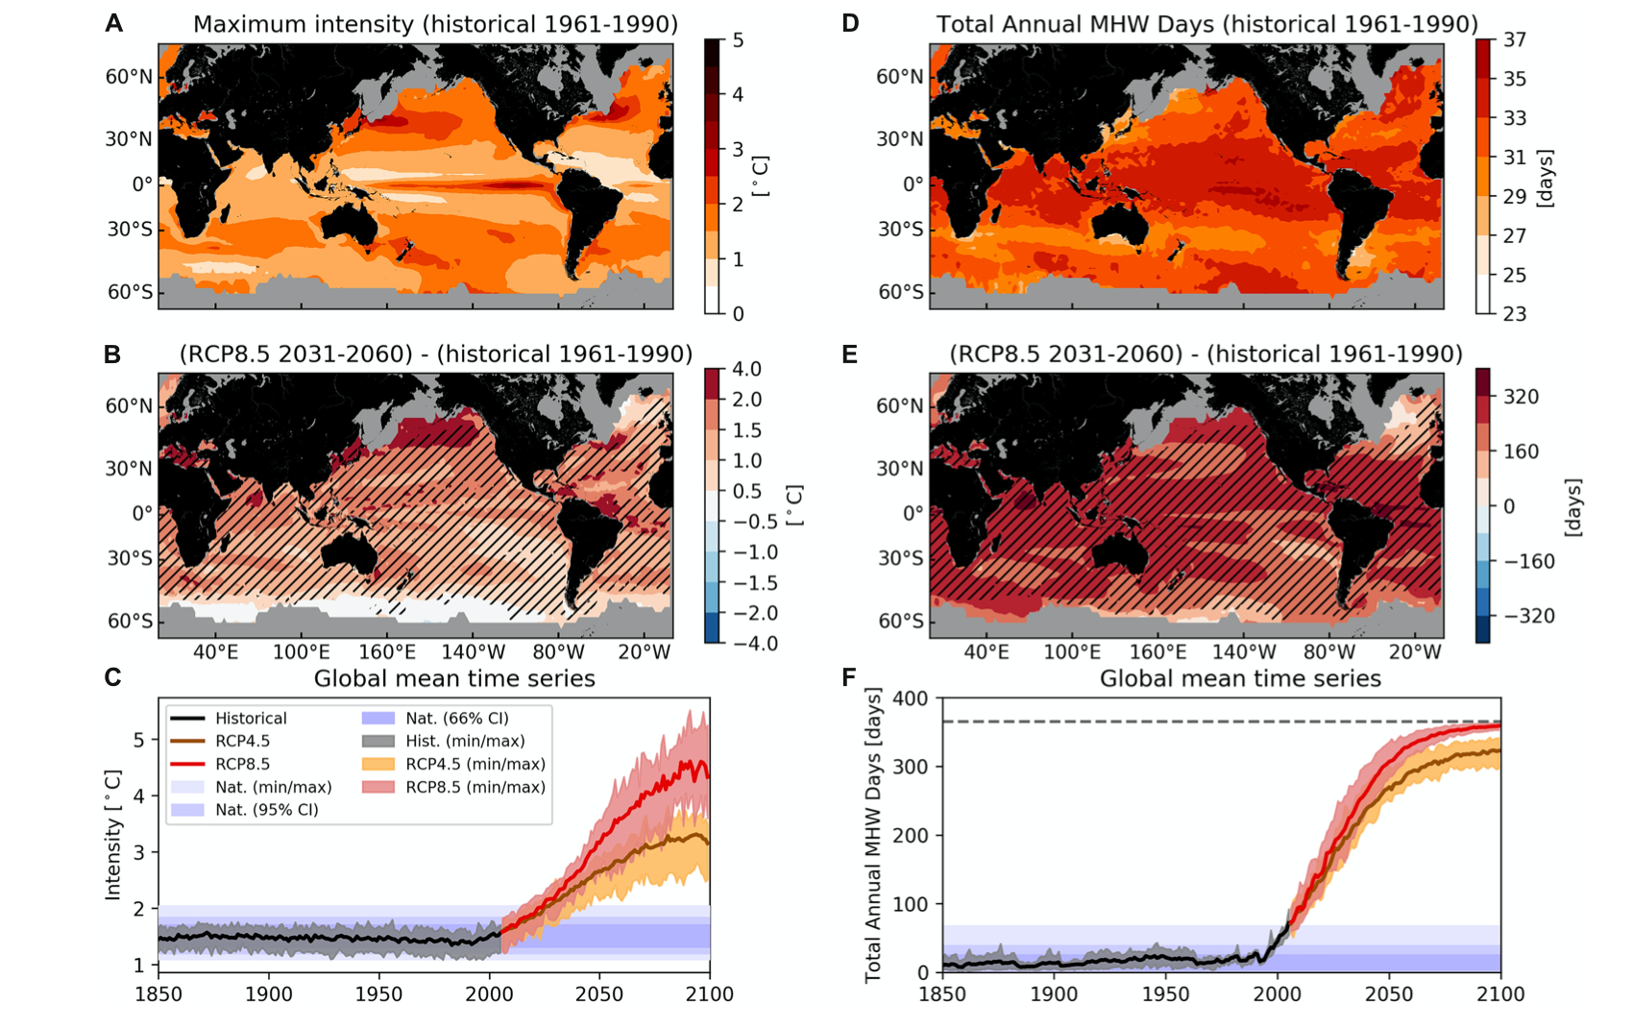
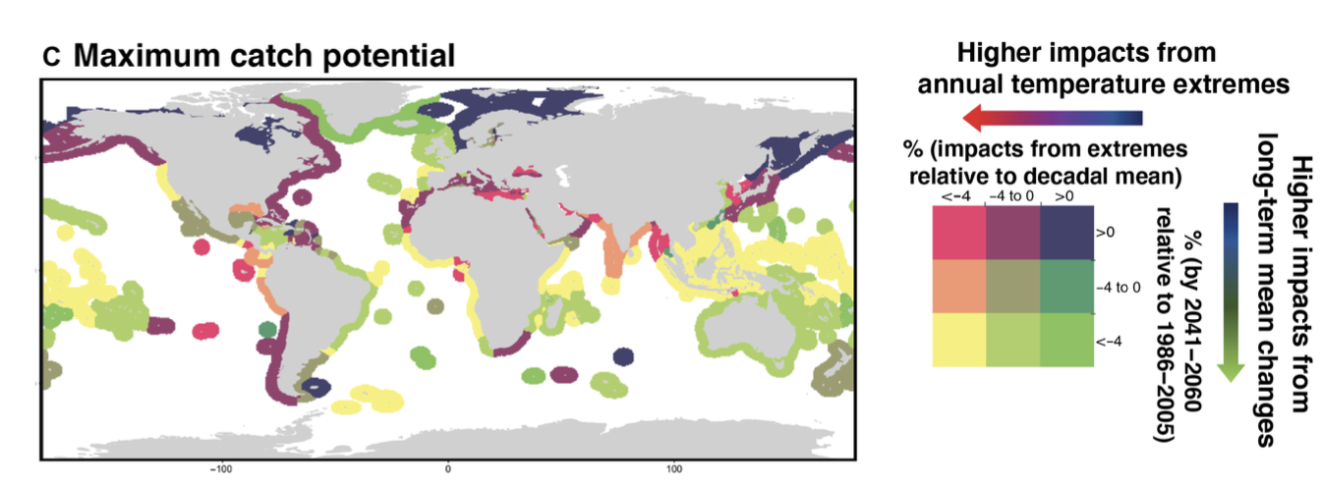
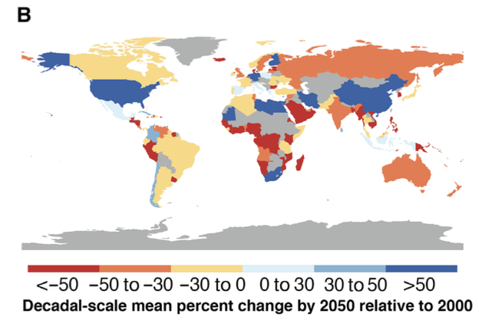
Introduction
MHWs in future climate
Frölicher et al. (2018; Nature)
CMIP 5 RCP 8.5
Oliver et al. (2019)
Probability
Spatial extent
Cheung et al. (2021; Sci. Adv.)
Notes:
Before we discuss the reversibility of the MHW, we need to know how they changed on the warming climate!
The figure shows how MHW intensity and days are changed under CMIP5 RCP 8.5 scenario compared to the historical period, which means that they used a stationary threshold.
We can find that the MHW tends to be more intensified and more long-lasting.
The intensity under both RCP 4.5 and 8.5 scenarios exceed the natural variability near 2030.
The duration exceeds the natural variability earlier.
Under the RCP 8.5 scenario, a full-year MHW occurred in the late 21st century.

Slide 3
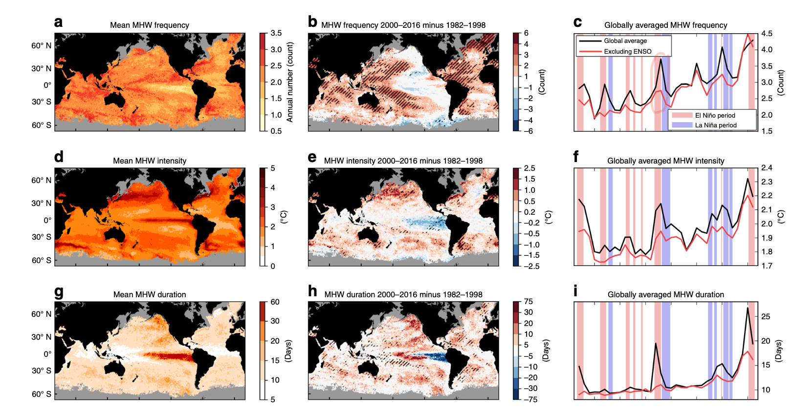
Observed MHWs in recent decades
(1982 – 2016)
Baseline period :
1983 – 2012
OISST
r = -0.59 with PDO
+0.45 events/year/decade
Related to ENSO
Observed MHWs trend in EAMS?
Oliver et al. (2018; NC)

Slide 4
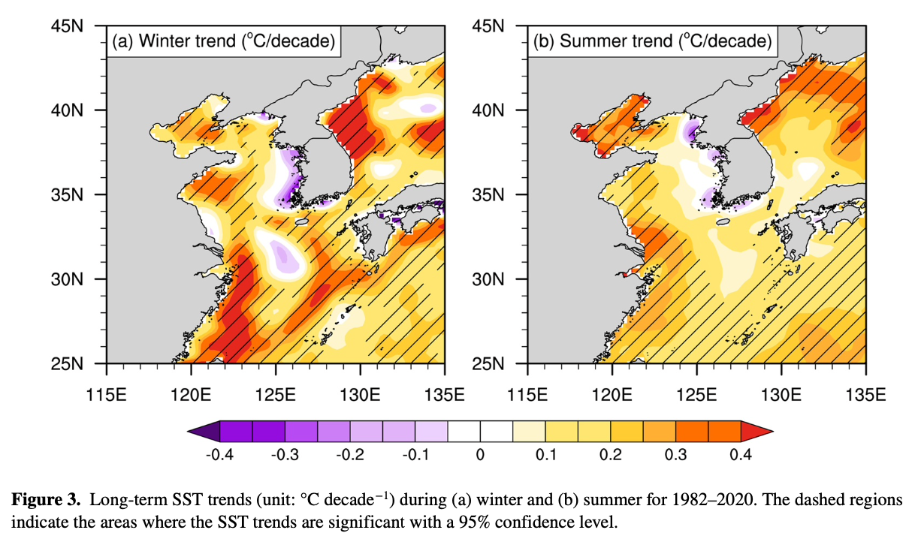
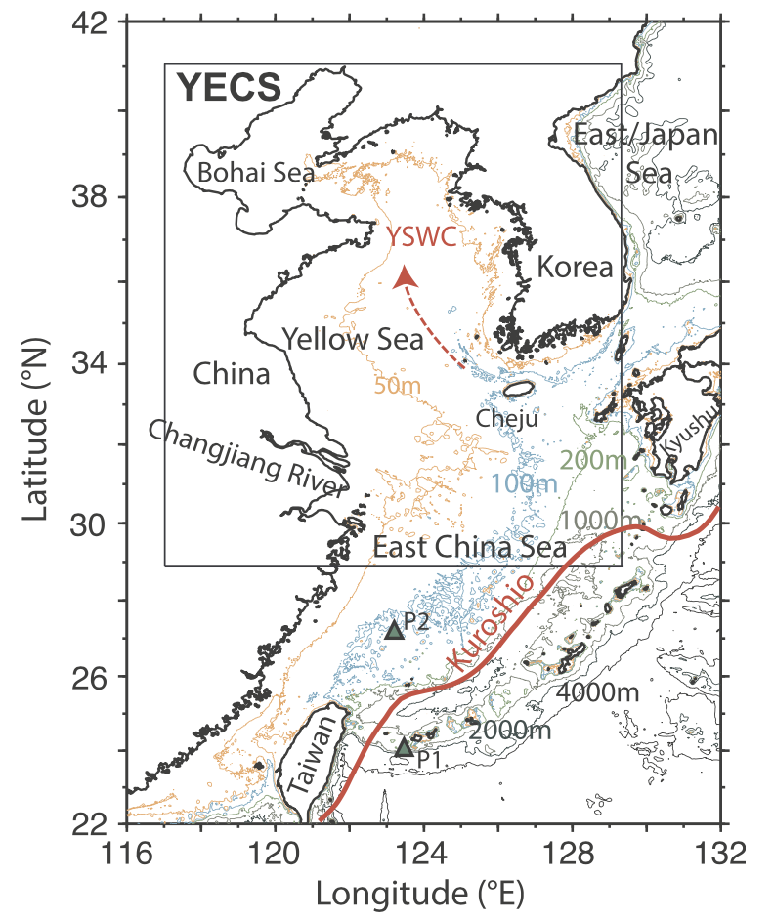
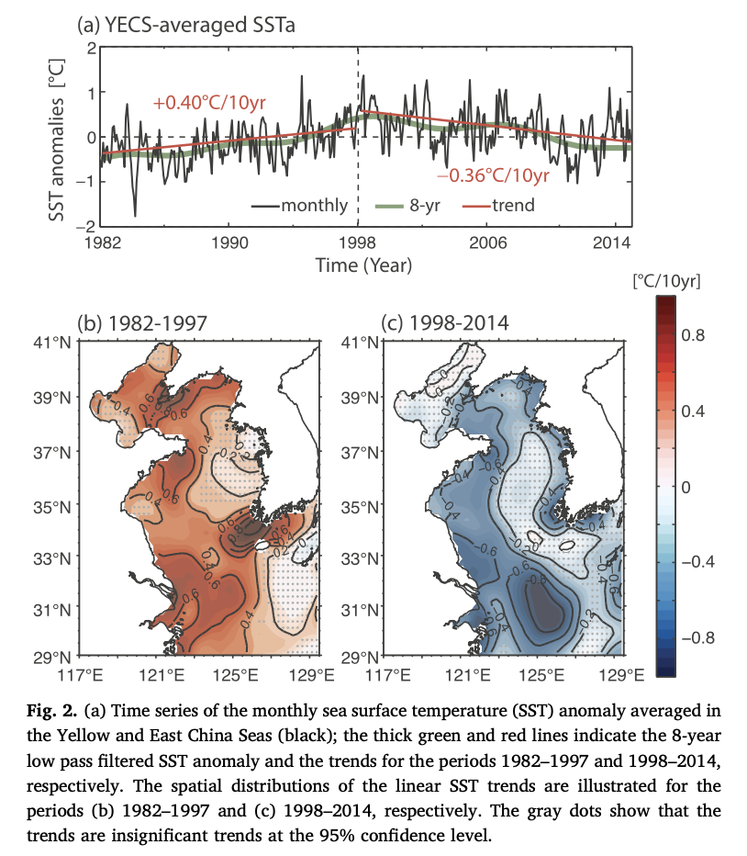
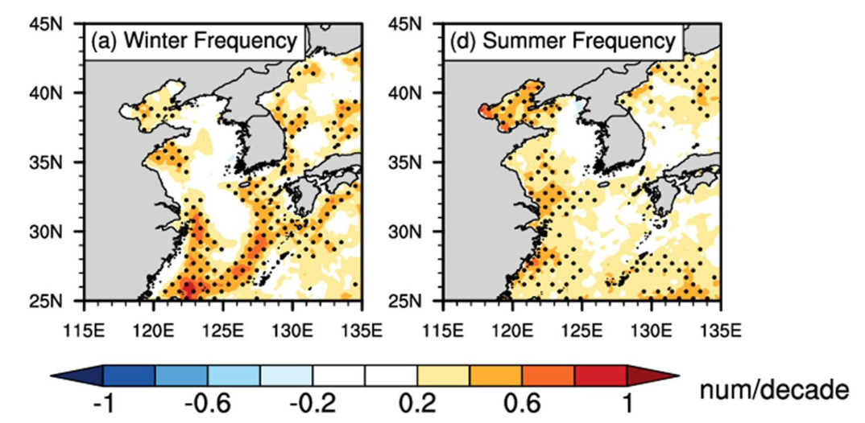
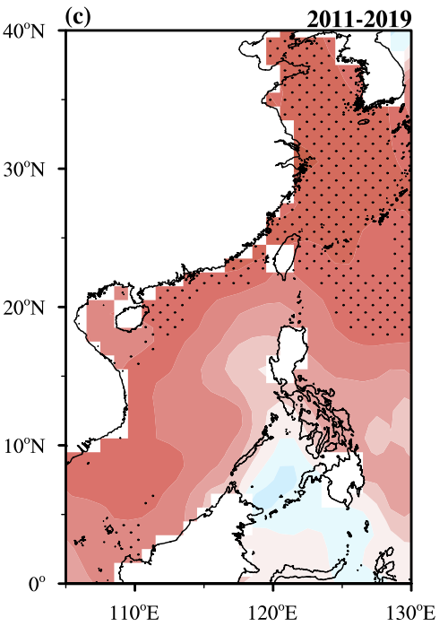
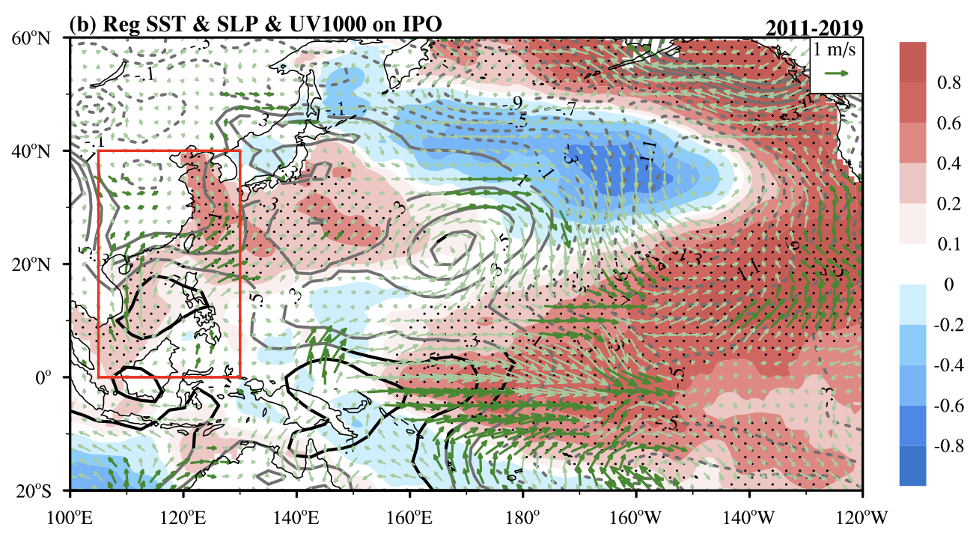
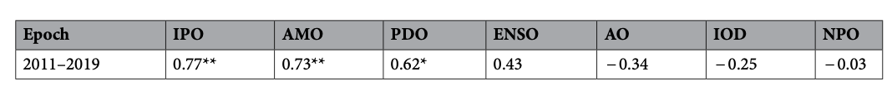
From previous studies (warming – hiatus period)
Kim et al. (2018)
Tang et al. (2020)
Lee et al. (2023)

Slide 5
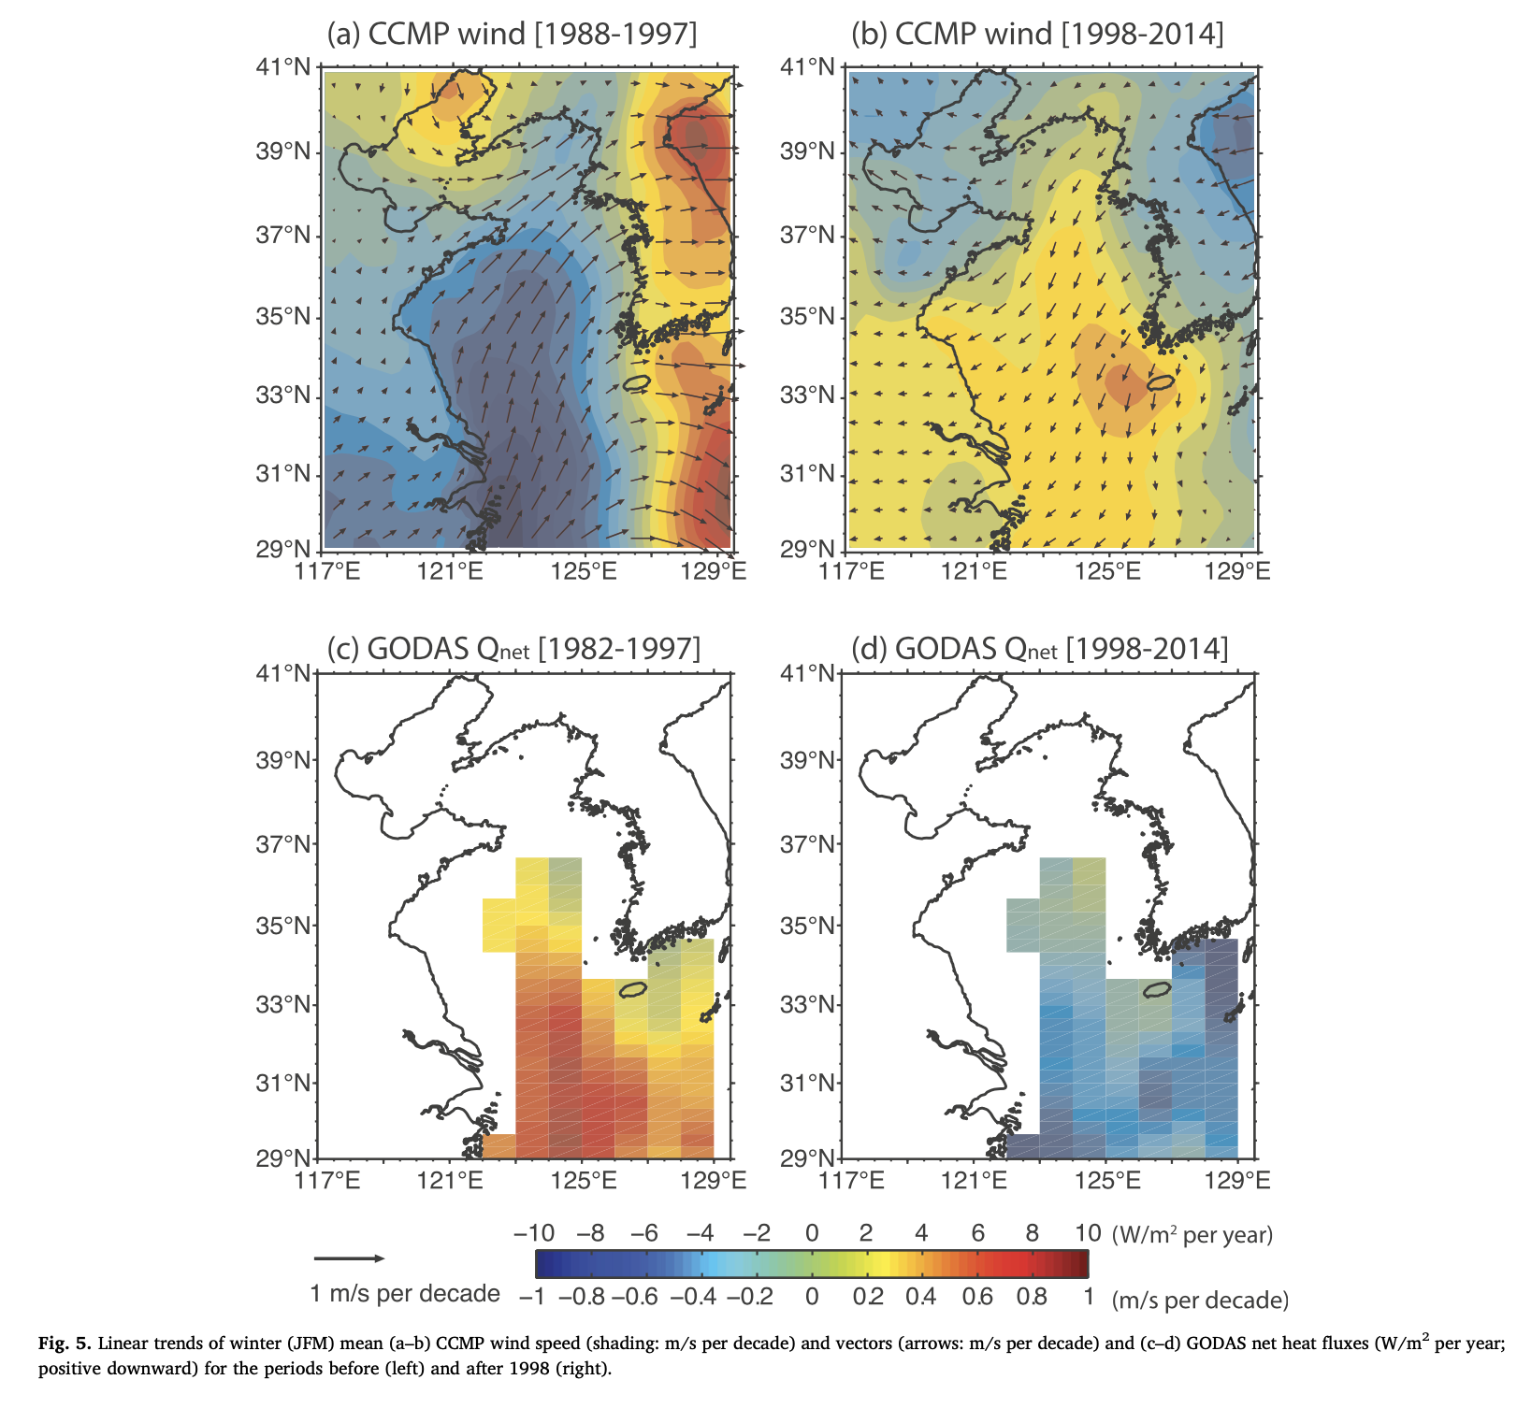
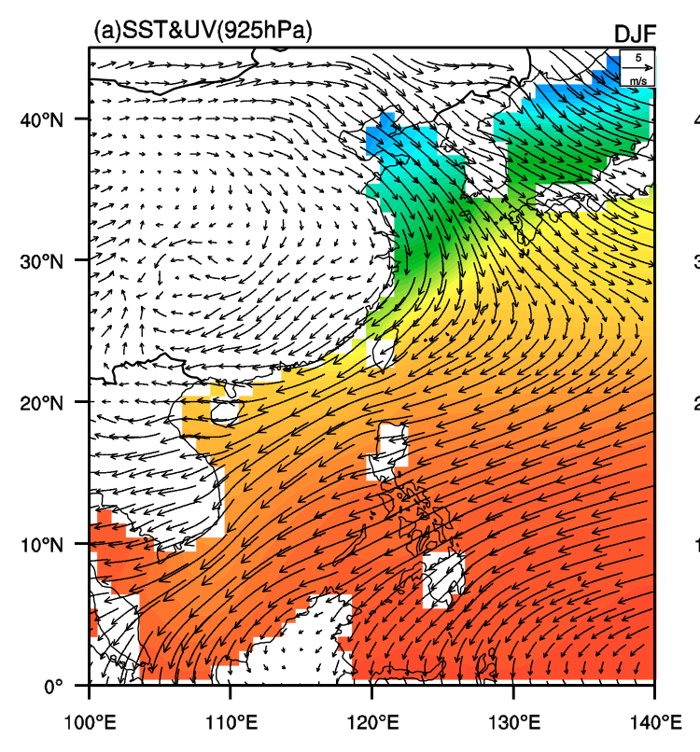
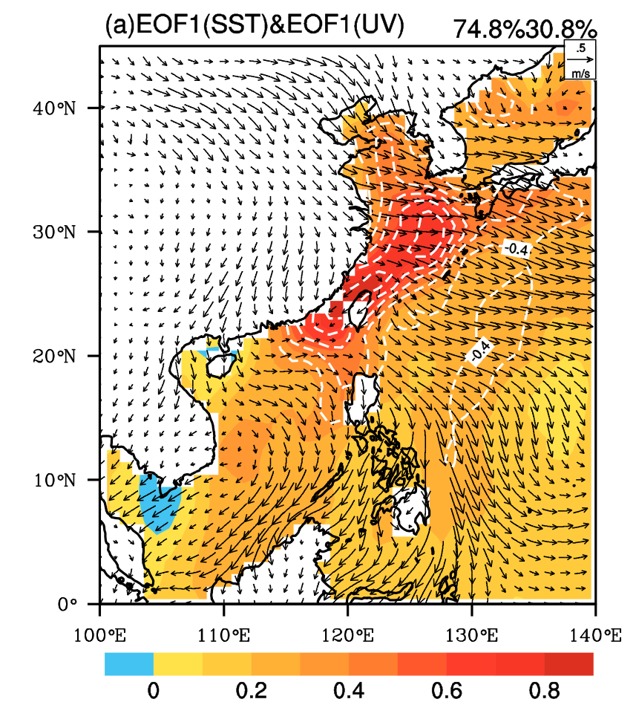
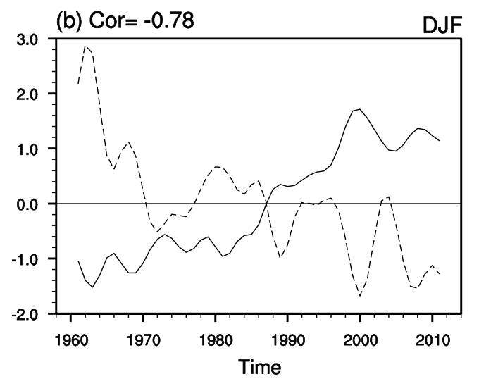
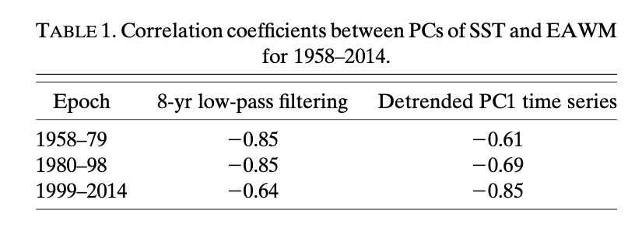
From previous studies (warming – hiatus period)
Physical mechanism:
The anomalous downward (upward) surface heat flux accompanied by the negative (positive) winter wind speed anomaly are related to the warming (hiatus) period
Significant correlation with EAWM during hiatus period
4.1. Atmospheric components: wind and heat flux
Kim et al. (2018)
Cai et al. (2017)
No significant correlation with KVT and Changjiang river discharge

Slide 6
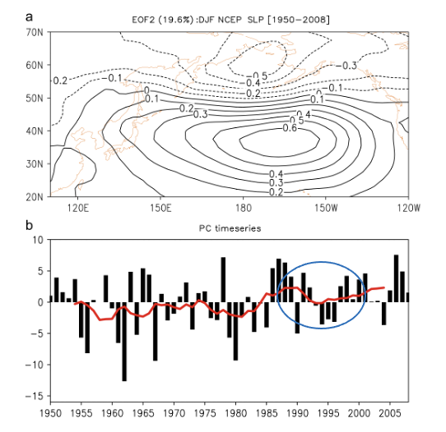
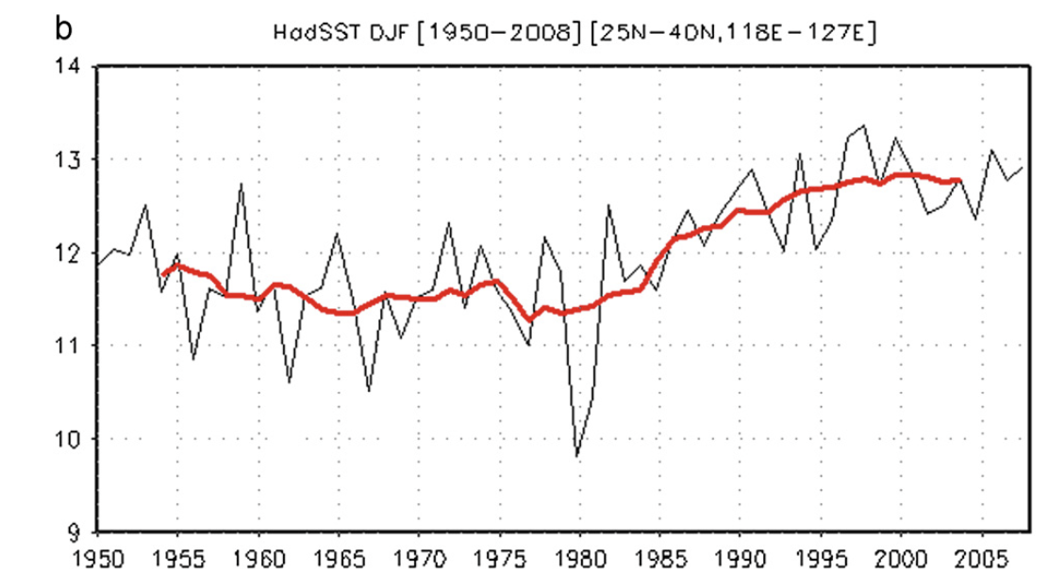
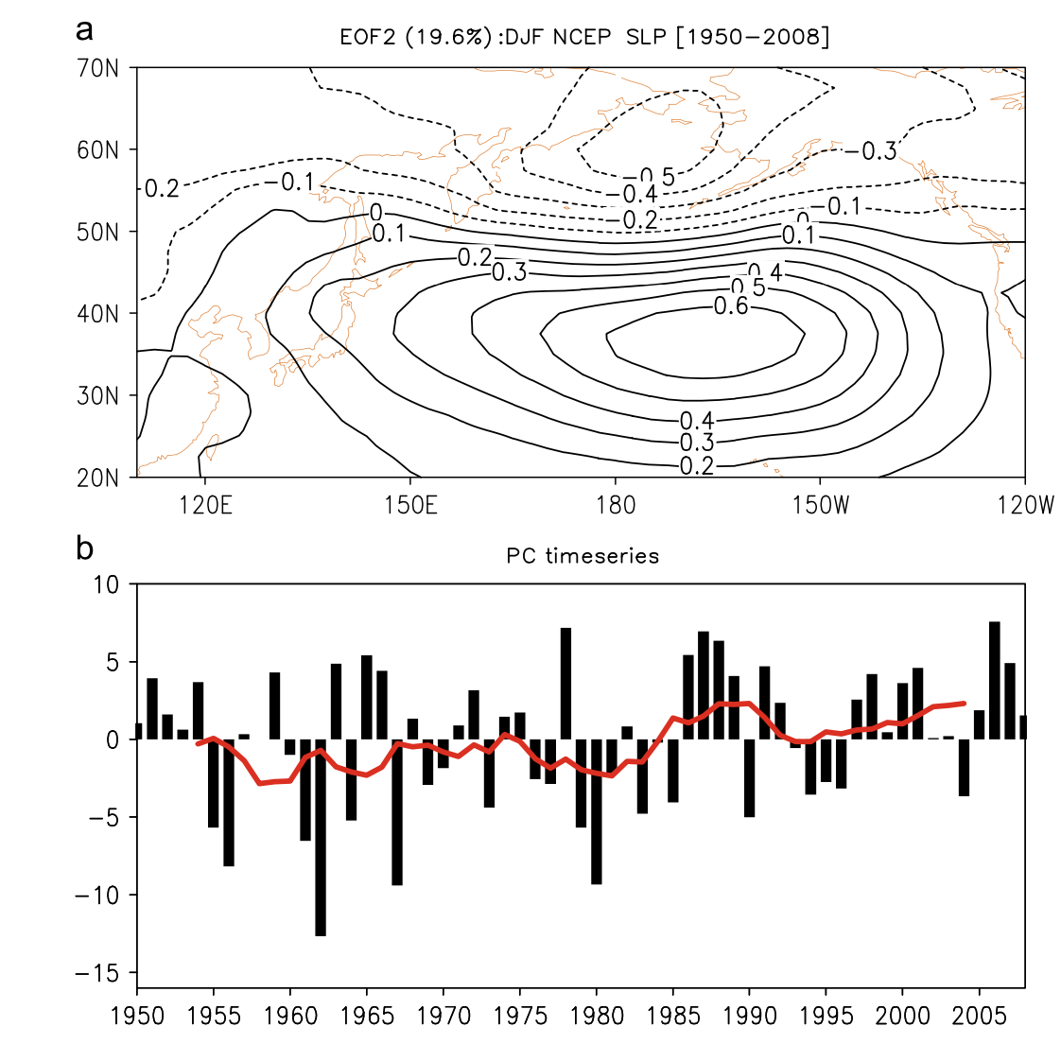
From previous studies (warming – hiatus period)
Canonical relation with Pacific (~1998)
Positive correlation between NPO and YECS from 1950-2000. exception in early 1990s.
The negative correlation with PDO index from 1900 ~ 1997, except for mid-1970 to early 1980s
SST (YECS)
NPO
r=0.79

Slide 7
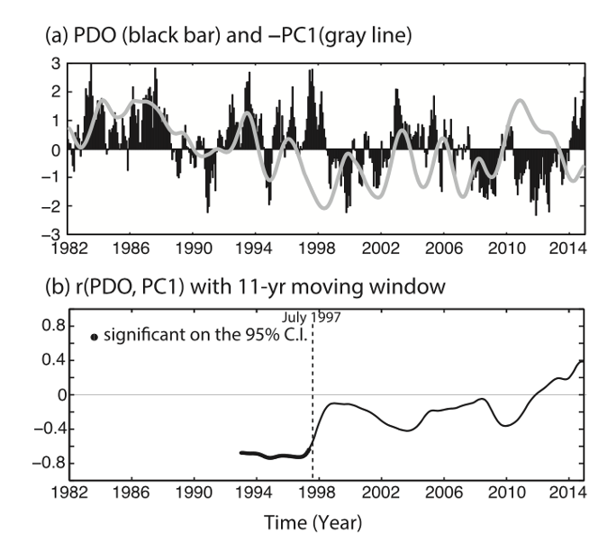
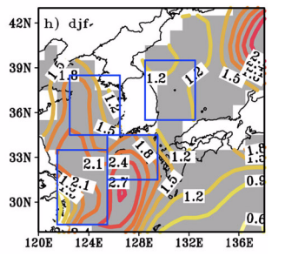
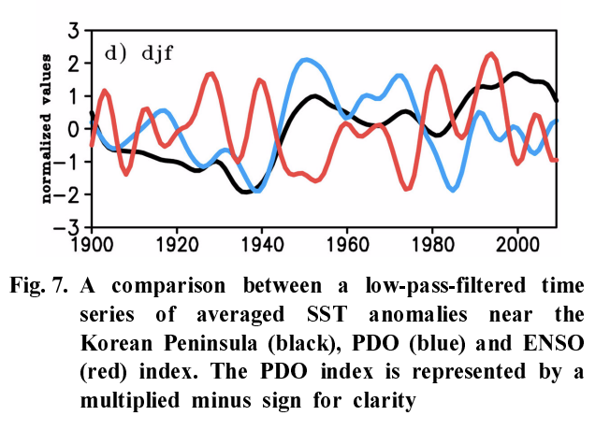
From previous studies (warming – hiatus period)
Canonical relation with Pacific (~1998)
Positive correlation between NPO and YECS from 1950-2000. exception in early 1990s.
The negative correlation with PDO index from 1900 ~ 1997, except for mid-1970 to early 1980s
Kim et al. (2011)
SST(KP)
PDO
Decorrelated after 1998?
Kim et al. (2018)

Slide 8
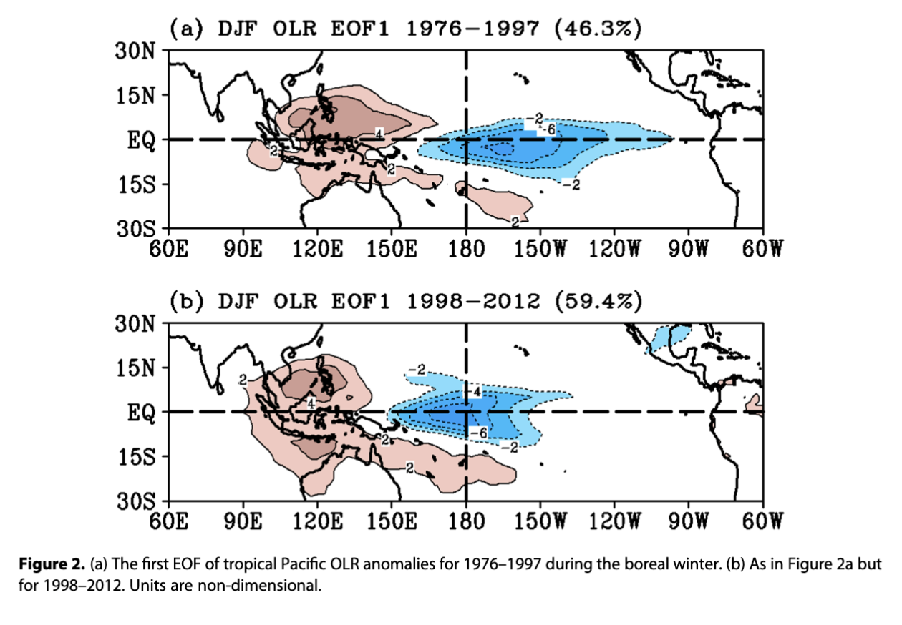
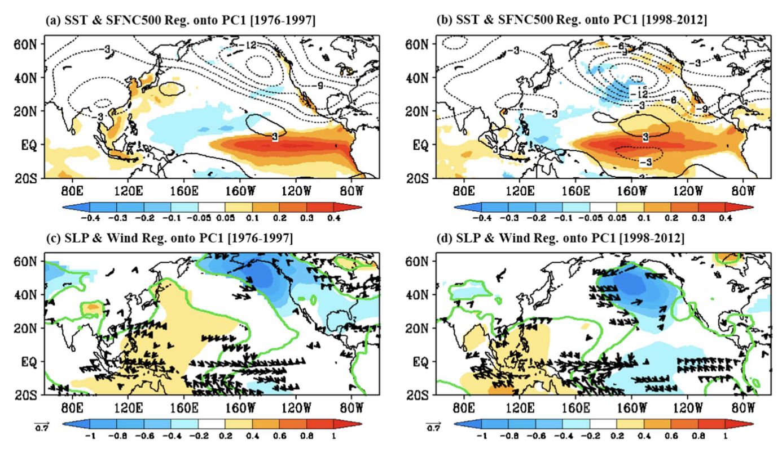
From previous studies (warming – hiatus period)
Regime shift in 1998s
As a response to the enhanced convective activity in central Pacific after 1998, tropics and extra-tropics connectivity changed (until 2012)
AL shifted westward after 1998
Jo et al. (2015)

Slide 9
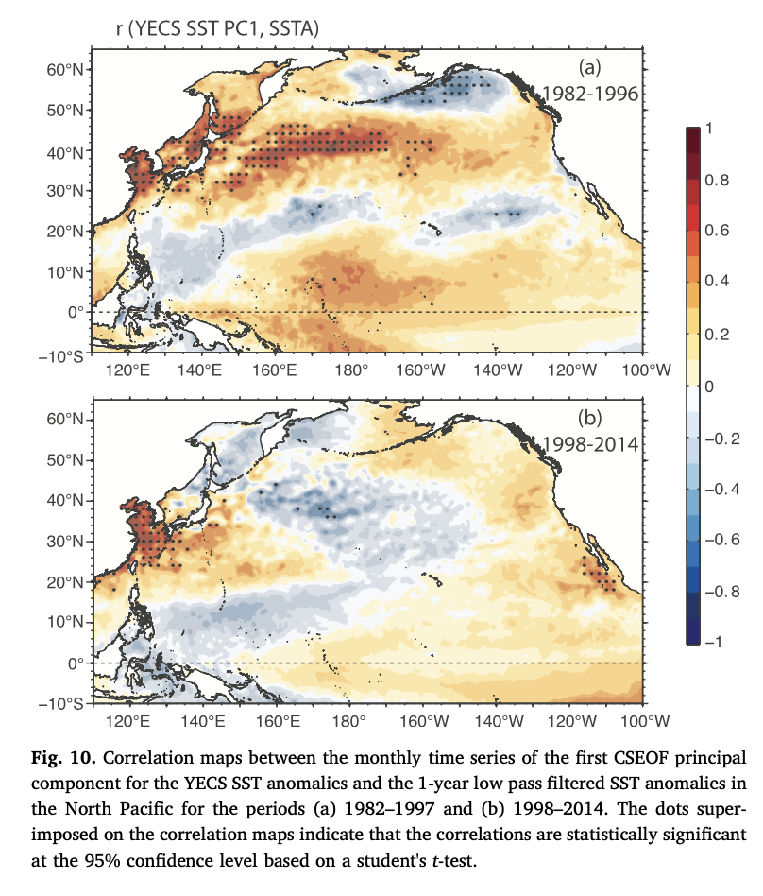
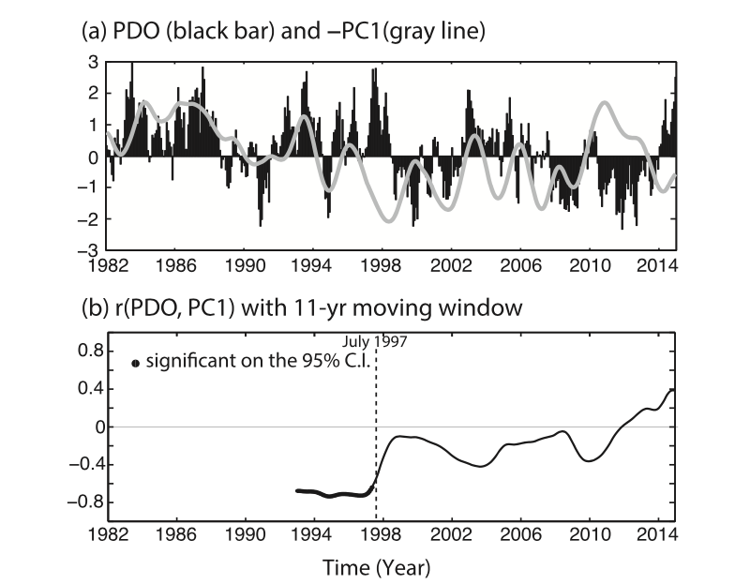
From previous studies (warming – hiatus period)
The SST pattern related to the PDO decoupled with YECS after 1998 (~2014)
After regime shift, NPGO-related SST pattern prevails.

Slide 10
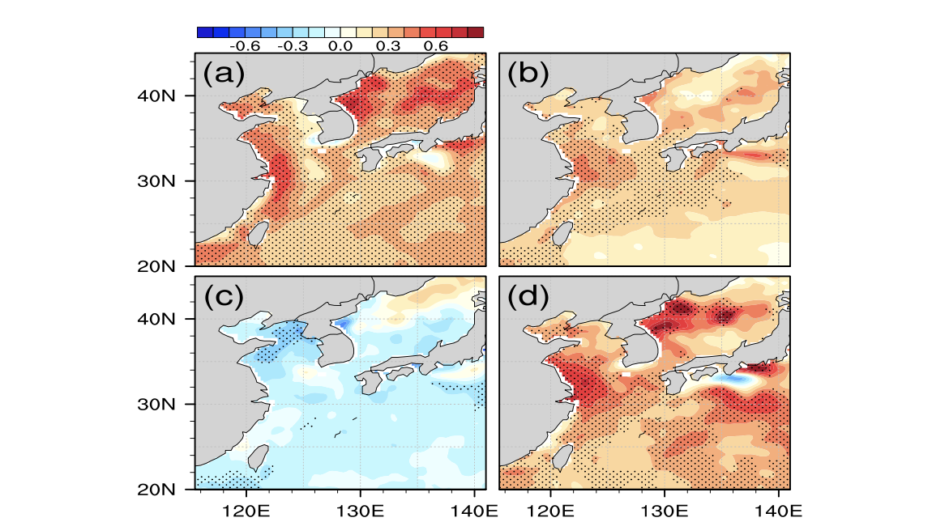
Spatial distribution of the SST Trend
warming
Warming (82-98)
Hiatus (98-11)
Reacceleration (11-22)
Hiatus
Reacceleration
Q1. Physical mechanism responsible for the
surface ocean warming during the reacceleration period?
Many previous studies
Need further investigation
Figure 4.2 Time series of annual MHW days normalized by the standard deviation (black line). Blue (red) lines represent the interannual (decadal) components with periods shorter (longer) than six years. Blue and orange shading indicates the normalized Niño 3.4 index. Vertical gray shading denotes years of El Niño to La Niña transition events.
Tang et al. (2020)
Green: SST
Q2. “Nonstationary” statistical relationship with decadal-scale climate variabilities?

Slide 11
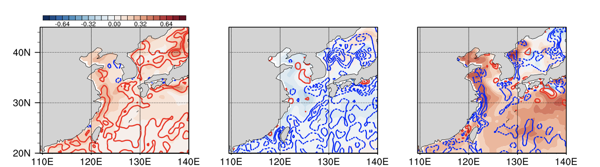
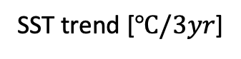
Q1. Physical mechanism responsible for the surface ocean warming during the reacceleration period?
Atmospheric influence
Contour: Q_{net} anomaly averaged during each period
CI=5 W m⁻²
Different to warming/hiatus period!
SST trend [$℃/3yr$]
Prominent SST increase in the coastal region of China coincided with the downward net heat flux anomaly, with a correlation coefficient of 0.63
SST warming during the reacceleration period despite of the anomalous heat loss to the atmosphere
And Wind…

Slide 12
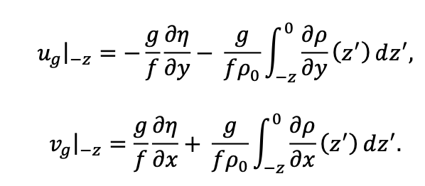
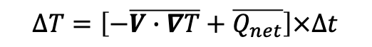
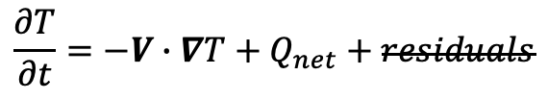
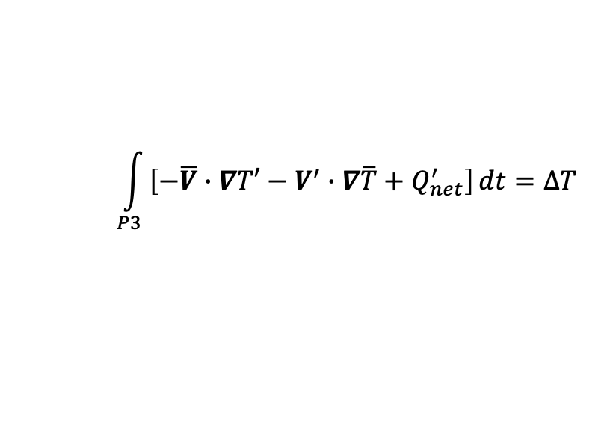
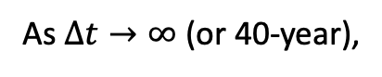
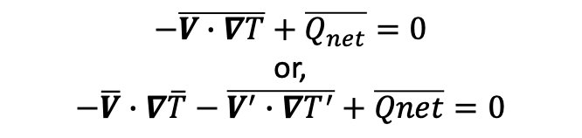
$$\frac{∂T}{∂t}=−V∙∇T+Q_{net}+residuals$$
Residuals include…
Vertical mixing related to the entrainment and/or convection
Diffusion
$$∆T=\left[−\overline{V∙∇T}+\overline{Q_{net}}\right]×∆t$$
As $∆t→∞$ (or 40-year),
$$−\overline{V∙∇T}+\overline{Q_{net}}=0$$
or,
$$−\overline{V}∙∇\overline{T}−\overline{V^{′}∙∇T^{′}}+\overline{Qnet}=0$$
$$\int_{P3}{\left[−\overline{V}∙∇T′−V^{′}∙∇\overline{T}+Q_{net}^{′}\right]}dt=∆T$$
Residuals from geostrophic current
are considered as “Ekman component”
As the integration period becomes longer, advection and heat flux will balance each other.
Based on the monthly SODA 3.4.2 dataset (0.5$°$ resolution)

Slide 13
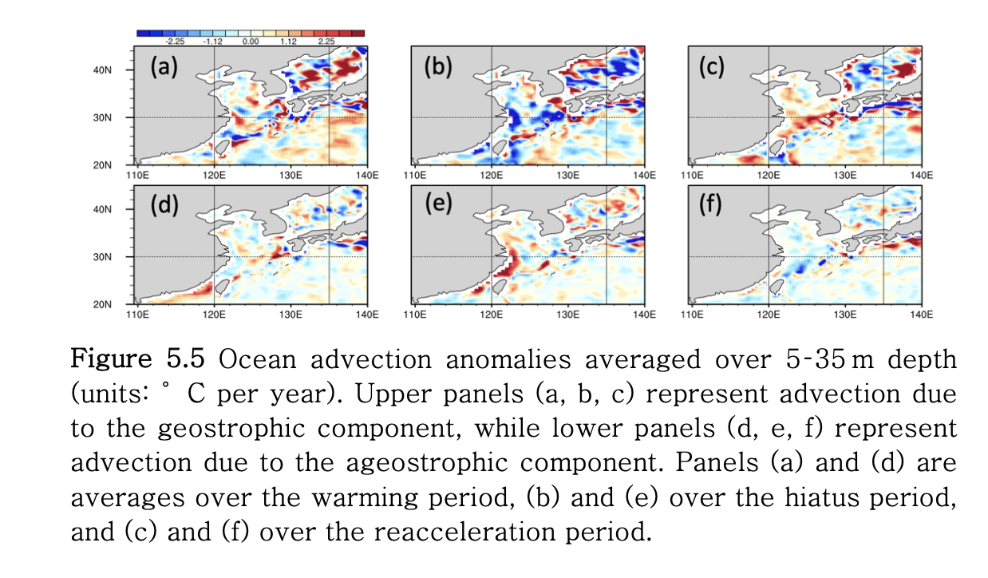
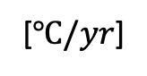
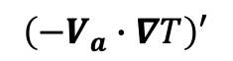
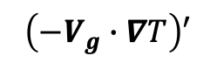
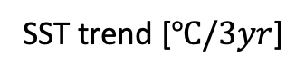
No spatial coherence in warming/hiatus period with advection
5-45 m averaged oceanic advection anomaly
Warming
Hiatus
Reacceleration
$$\left(−V_{g}∙∇T\right)′$$
Integrating 10 W m⁻² for one year could lead to the increase of 50m-depth mixed layer by 1.5 °C.
integrating from 1982 to 1998 could increase temperature 20°C, which should be compensated by the oceanic component.
The cumulation of error inherent to the reanalysis data makes the close of budget more difficult.
→ oceanic circulation increases ocean temperature, which should be released to the atmosphere through upward heat flux.
$$\left(−V_{a}∙∇T\right)′$$
[$℃/yr$]
SST trend [$℃/3yr$]
Compensate each other!
?
Wind → U_{g} vs. U_{a}

Slide 14
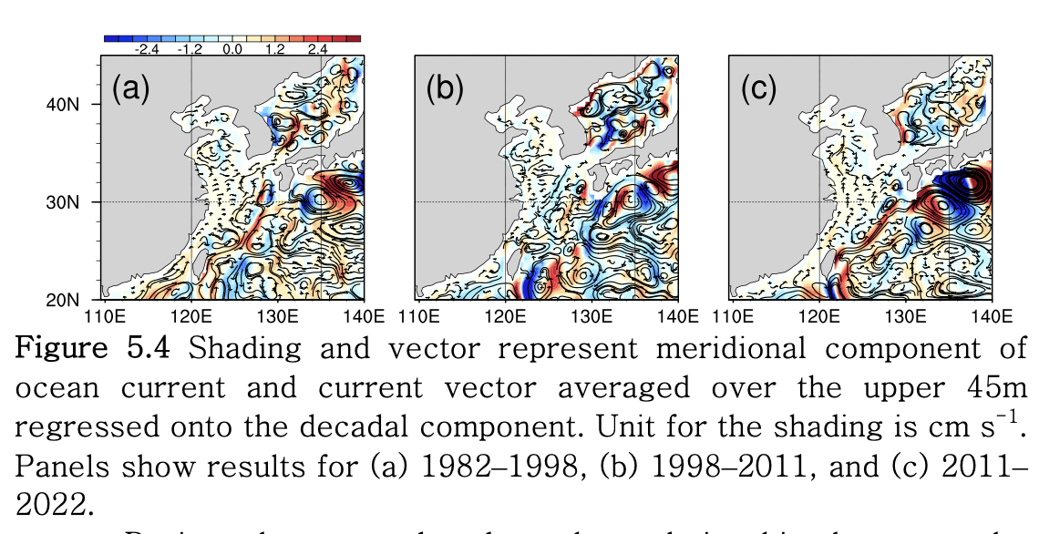
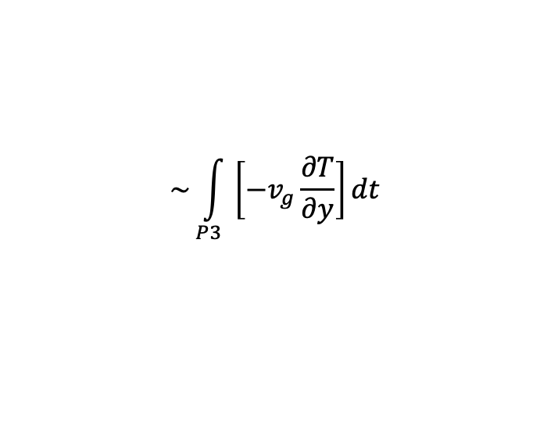
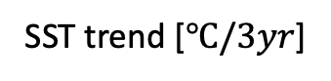
SST trend [$℃/3yr$]
Northward current anomaly
Warm advection anomaly
SST trend
v anomaly [cm s⁻¹]
$$\sim \int_{P3}{\left[−v_{g}\frac{∂T}{∂y}\right]}dt$$
Relationship with wind?

Slide 15
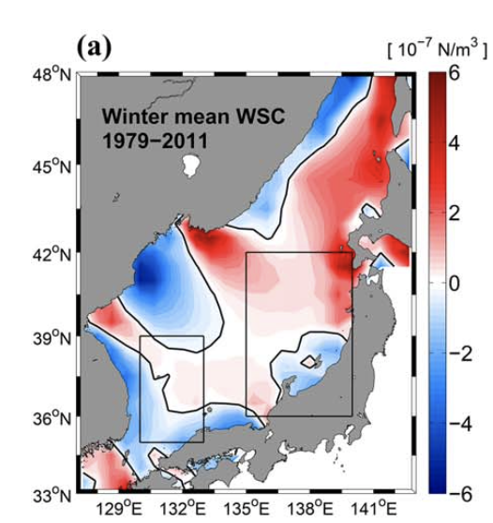
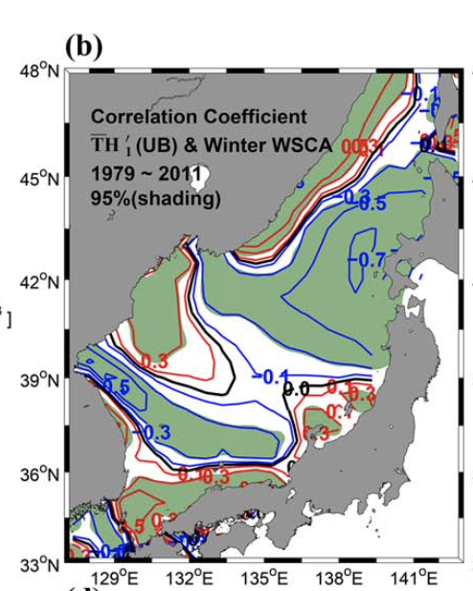
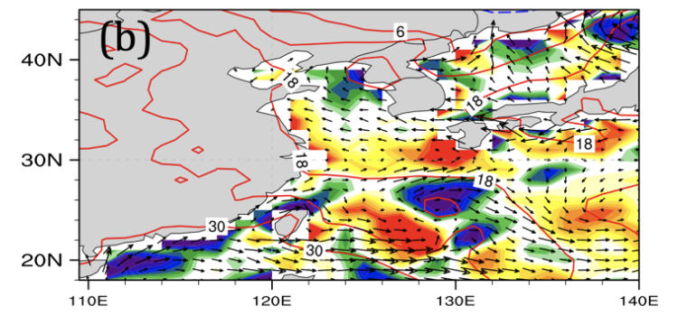
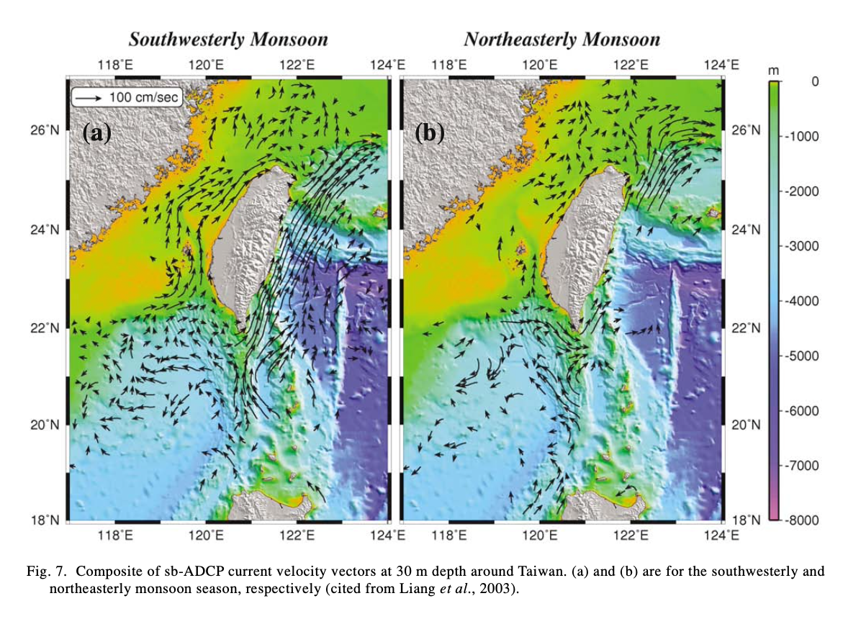
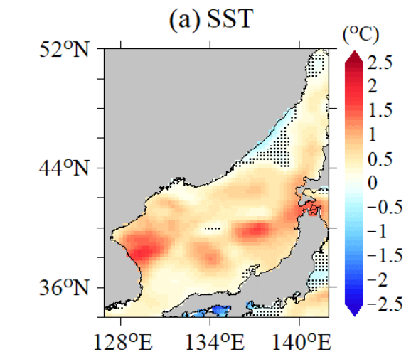
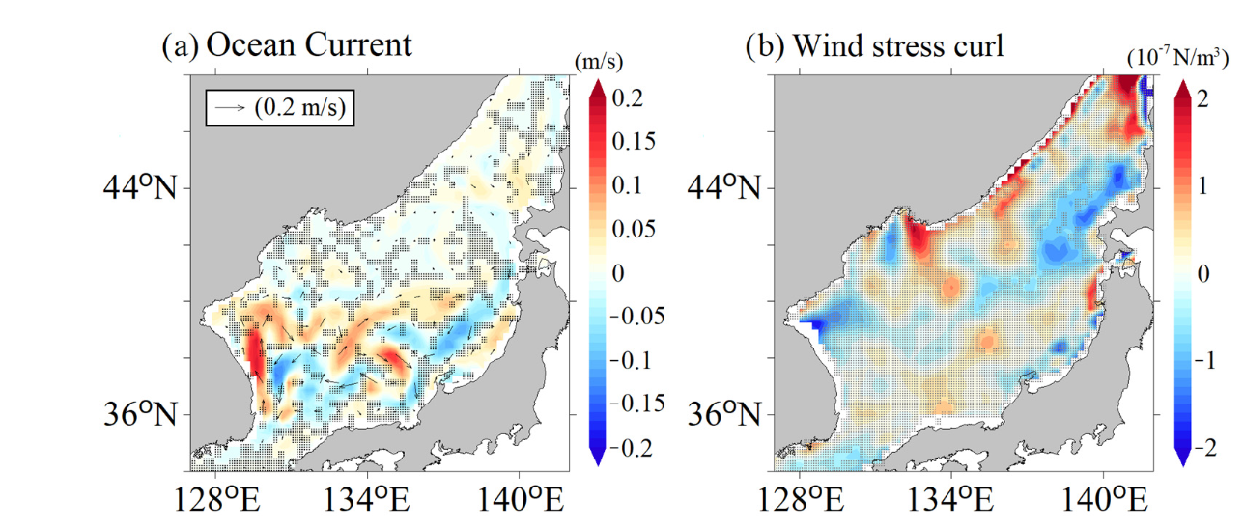
Discussion
Wind stress & WSC anomaly (Reacceleration)
10⁻⁸ N·m⁻³
Yoon et al. (2016)
The positive WSC in the EKB was shown to influence the separation of the EKWC [Kim and Yoon, 1996; Yoon et al., 2005].
Trusenkova et al. [2009] suggested that the anticyclonic WSC forcing results in the stronger EKWC and northward shift of the TWC.
Choi et al. (2022)
Hu et al. (2010)

Slide 16
Q2. Statistical relationship with decadal-scale climate variability?
6 year low-pass filtered
Detrended decadal component
PDO
NPGO
IOBM
EAWM
Figure 5.5 Time series of the detrended decadal component along with various indices. The red line represents the PDO index, the green line the NPGO index, the blue line the EAWM index, and the purple line the IOBM index.
Figure 5.6 Moving window correlation between the detrended decadal component and various other time series. The moving window width is set to 15 years. The red line represents the PDO index, the green line the NPGO index, the blue line the EAWM index, and the purple line the IOBM index.

Slide 17
Regressed SST and SLP
P1 (1982−2006; 25-year)
P1
82-02
89-95
92-99
85-06
PDO
NPGO
IOBM
EAWM
P2
P2 (2002−2022 ; 21-year)
Correlation between SST in WNP and its marginal seas and NPGO & PDO reversed in late 2000s (compared to the correlation prior to regime shift)
Kim et al. (2018)

Slide 18

Figure 5.8 Regression coefficients of SST anomalies (shading; units in °C) and SLP anomalies (contours; contour interval is 30 Pa) onto climate indices. Panels (a) and (b) are for the PDO, (c) and (d) for the NPGO, and (e) and (f) for the IOBM. The left column represents the first period, and the right column represents the latter period. Note that the periods used for the calculations differ.
Spatial distribution of SST pattern related to the PDO and NPGO changed in 2002-2022
Connectivity with Pacific ocean re-appeared but in different ways

Slide 19


r=0.6
r=0.75
Reacceleration
The SST variation from late-hiatus to the reacceleration period correlated with the NPGO index (r= 0.6$\sim$0.75, p<.05)

Slide 20
Conclusion
Q1. Physical mechanism responsible for the surface ocean warming during the reacceleration period?
Rapid warming of the East Asian seas was primarily coincided with warm oceanic advection associated with a northward current anomaly differing from the previous warming period (1982–1998) when downward heat flux anomalies dominated
Previous studies suggest that anomalies in wind stress and WSC may explain this northward current anomaly
Q2. “Nonstationary” statistical relationship with decadal-scale climate variabilities?
Correlations between SST in the East Asian marginal seas (EAMS) and Pacific decadal modes (PDO and NPGO) have reversed compared to earlier periods
Previously negative correlations with PDO (and positive with NPGO) shifted to positive correlations with PDO (and negative with NPGO), limiting predictability based on historical patterns
Limitations
On decadal timescales, residuals and accumulated errors in ocean reanalysis data prevent closure of the heat budget
Determining why patterns of Pacific decadal variability have changed from the past, and separating these changes from anthropogenic warming effects, is beyond the scope of this research and remains an ongoing challenge

